Slide 1
Convergence Point System Architecture
Claim Auditing Platform
May 15, 2015

Slide 2
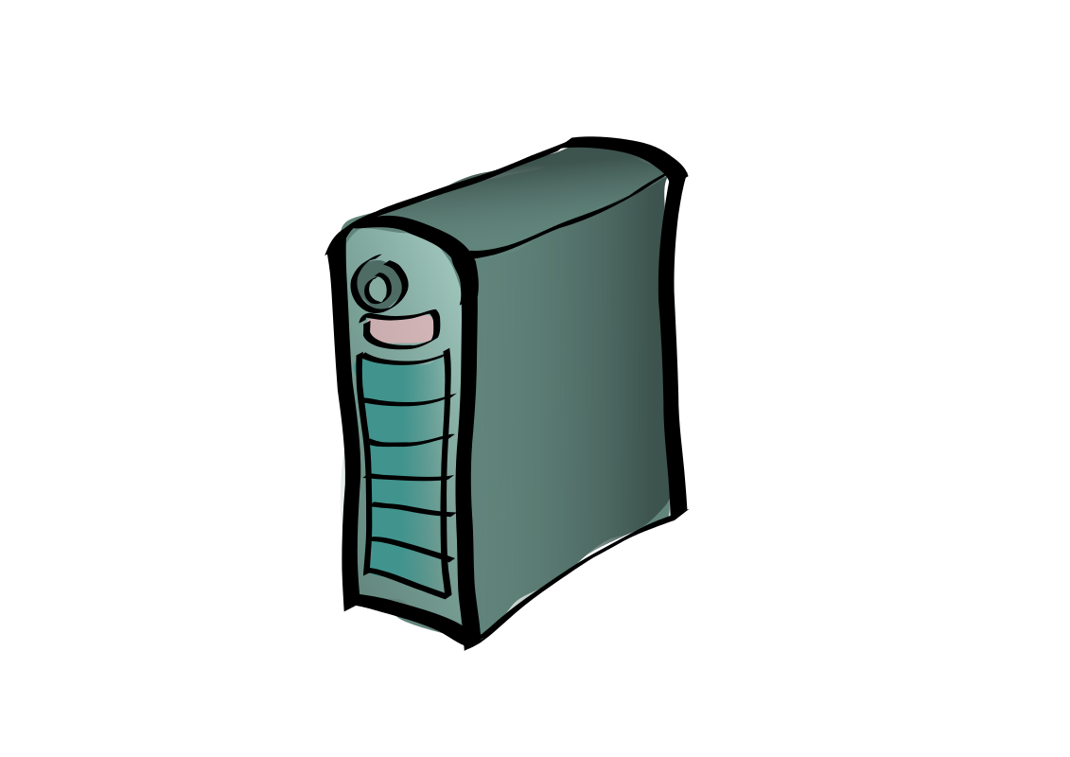


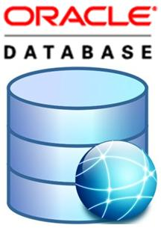


Convergence Point Deployment Architecture
CURE
(there is a whole new world out there)
Warehouse / Analytics
(there is a whole new world out there)
Portal
Cluster
DMZ
Load Balancer
Business Process User Interface
Nexxus Schema
Load Balancer
Real-time
Submissions
Gateway
Cluster
Common V3 Schema
Payor Schemas
Application
Cluster
Load Balancer
Oracle Cluster
Firewall
Applications Integration
Perimeter Cluster
Payor Data/Configuration (Network File System)
Bridge Cluster
Messaging
Cluster
RTN Cluster
Batch
Submissions
(Push/Pull)
Untrusted
Trusted

Slide 3





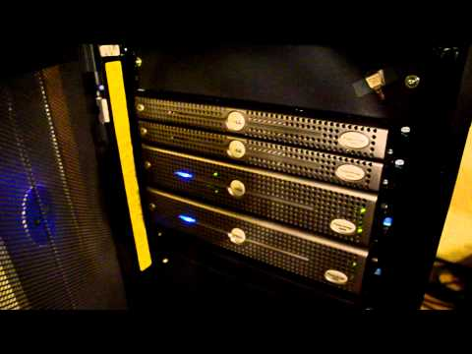




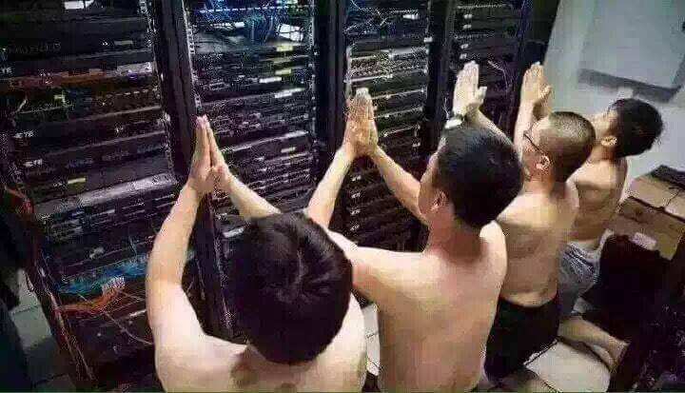

Software Development and Implementations Lifecycle
Architects and Implementations Team put together a solution by gluing the components together to form a solution
Solution for Payor 1
CVP Components and Services
Solution for Payor 2
Environments
Eric Farrar
Software Engineers develops platform services and components
Operations, DevOps, Network Engineers manage and maintain the solutions

Slide 4


Batch Processing Flow
<starts workflow >
SFTP
Server
Perimeter
Service
Workflow
Event
Generator
Business
Process
Service
Internet
<writes>
<scans>
Perimeter
Service
<executes>
Business
Process
Service
Business
Process
Activity
Fetch
Server
Business Process Model
<instantiates>
<executes task>
Bridge
CLI
Pipeline
Stage
Workflow
Attendant
Scripts
Workflow
Attendant
<executes>
<feeds UOW>
Pipeline
<executes>
RTN
Task
RTN Process Flow
<sends UOW>
RTN
<feeds UOW>
RTN
Deepthought
RTN
Deepthought
Deep Thought
<feeds>

Slide 5
Real Time Processing Flow
<feeds message>
Web Services
Socket Bridge
VPN
Socket Bridge
Pipeline
Stage
<feeds>
<sends task chain >
Pipeline
RTN
Deepthought
RTN
RTN
Task
<feeds >
Deepthought
<sends work list>
Deep Thought
RTN Process Flow
<feeds>

Slide 6
Components Description
Perimeter Service
Looks for new files from users
Moves them to inside DMZ
Starts business process instance by starting Workflow Event Generator
Workflow Event Generator
Creates JMS message
Sends message to Business Process Service
Business Process Service
Manages business processes
Manages business process instances
Starts business process instance
Feeds external events to a business process instances
Manages user tasks notifications and panels)
Workflow Attendant
External agent for processing task requests from the Business Process Service
Executes Ant tasks (and Groovy!!)
Bridge CLI
Container for running and feeding pipelines
Ability to split batch files into smaller units of work
Units of work are fed to pipelines specified by command line parameters
RTN
Container for processing units of work from the pipeline
Each tasks in the worklist are executed in a specified order
Has the capability to send end results to JMS queues for further processing

Slide 7
Components Description (continued)
Web Services
Frontend system for serving web services requests from clients and partners
Feeds incoming requests to the backend system
Processes requests from the backend system to communicate with client/partners by consuming web services
Extensive support for throttling and throughput management
Support for configurable flows (routes)
Socket Bridge
Container for feeding pipelines
Receives requests from frontend systems
Oracle Database
Data store for intermediate, raw resolved and processed data
Data store for reference data used while processing transactions (example ICD10 diagnosis codes)
Data store for workflow configuration data
Feeds backend Analytics systems
SQL Loading is regularly used to extract, transform and load custom formats
Extensive list of SQL scripts and stored procedures to load, resolve, sequence and partition data.

Slide 8
Components Description (continued)
Business Process Model
Configurable orchestration at the highest level covering the end to end process
A business process consists of activities chained together with support for conditional flows, pauses for manual activities, parallel flows among many other features
BPMN2 compliant
The process model can be created/modified using Eclipse IDE
Supported integrations include
Java, Spring, EJB and Web Services
Interface with the Workflow Attendant for running and distributing processor intensive tasks
Interface with the Workflow Event Generator for instantiating business processes
Workflow configuration and data access
Ant Scripts (Claimsguard.xml)
Enables customization by allowing custom scripting on a realm basis
Scripting capabilities include
File system operations
Run Java executables
Run SQL scripts
Archiving operations
Send emails
Pipeline
Configurable process flows for processing requests
Supports chaining of stages as well as content based routing, filtering, conditional flows and exception handling
Multiple threading models available
Has extensive support for performance tuning
An extensive list of pipeline stages available for routine processing including parsing, mapping, validating, etc.
New stages can be plugged in easily.

Slide 9
Components Description (continued)
RTN Tasks
A collection of tasks available for real-time processing of units of work including
History retrieval
Unit of work retrieval
Message validation and resolution
Message sequencing
Message persistence
Message routing
Task throughputs are tunable
Configurable task chains enable creation of a flow where multiple tasks process a unit of work sequentially
EDI Beans
A library for processing EDI messages
Marshalling
Unmarshalling
Validation
Mapping
Can be chained together in a pipeline to create ETL flows
Supported formats include
CIF
ANSI X.12
Custom formats can be added (and is routinely added)
Support for SEF-based validation and well-formedness checks
Used by Pipelines and RTN tasks

Slide 10


Components Description (continued)
Activiti Explorer
Web-based user interface for
Managing business process models
User task management
Administering/Viewing Business process instance status
Viewing process reports
Administering users and groups
Deep Thought Rules Engine
Portal
A web application for customers’ to view and manage audits
Next Gen Portal
Used for resetting password ONLY!! ☺

Slide 11
Enterprise Data Definition Repository (EDDR)
Fancy name for a database containing the definitions of transaction data
Contains all data element definitions organized in the following hierarchy
Dictionary
Segment
Data Elements
Used for code generation of
Classes for domain objects
SEF (used by EDI validation)
Classes for database query service
Classes for database persistence service
Database table definitions
Stored procedures for Loader, Resolver, etc.
CIF parser and formatter
Etc.
Velocity/Freemarker template driven code generation so that – infinitely customizable

Slide 12
Technology Stack
Runtime
Java 8 (almost ☺)
Spring 1.x, 2.x, 3.x, 4.x (being upgraded to Spring 4.x)
Apache Activiti 5.16.1
Jboss HornetQ 2.2.14 (being upgraded to 2.4.1)
Jboss Wildfly 8.1
Apache Camel 2.16.1
Oracle Enterprise 11g
Redhat Enterprise Linux
Development
Maven
IDE of your choice
Activiti IDE
Database tool
Git and Git Flow
Virtualized environment for testing

